Slide 1
UGBA 141 Production and Operations Management
Queue I Little’s Law + Intro to Queueing
Professor Park Sinchaisri
Notes:
Agenda
Capability Analysis + Six Sigma
Ritz-Carlton Case
Service Excellence

Slide 2
Course Announcements
Agenda: Little’s Law/Rent the Runway + Intro to Queue HW5 out (7 Qs on Queue, 3 Qs on Revenue Mgmt) This week: 2nd Project Sponsor Meeting
Two last boba chats: Today + Wednesday (boba on me!)
Today: Access to Littlefield platform + demand data
Friday: HW4 due (you can submit either HW4 or HW5)
Next Week: 75-hour online Littlefield Simulation
Starts Monday 1pm and ends Thursday 4pm
No classes on Mon/Wed, make-up on Friday

Slide 3
Littlefield Preparation
Read the handout (also on bCourses/files/Littlefield)
Watch 6-minute walkthrough video (on bCourses/Media Library)
Analyze historical data (first 50 days)
Historical processing times (on bCourses/files/Littlefield)
Historical demand data (on the platform, access after class)
To perform well, you need to analyze these data
Simulation runs from Next Monday 1pm to Thursday 4pm
30 minutes in real life = 1 simulated day in the game
You will manage Days 51-200, your final decision will be used for Days 201-300 (automatically simulated after Thursday 4pm).

Slide 4

Littlefield Access
https://bit.ly/haaslittlefield
Right after class today, you’ll receive (temporary) Team ID and password.
Come up with your team name and let me/GSI know by Wednesday.
Multiple team members can log in at the same time.

Slide 5
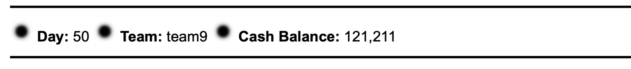
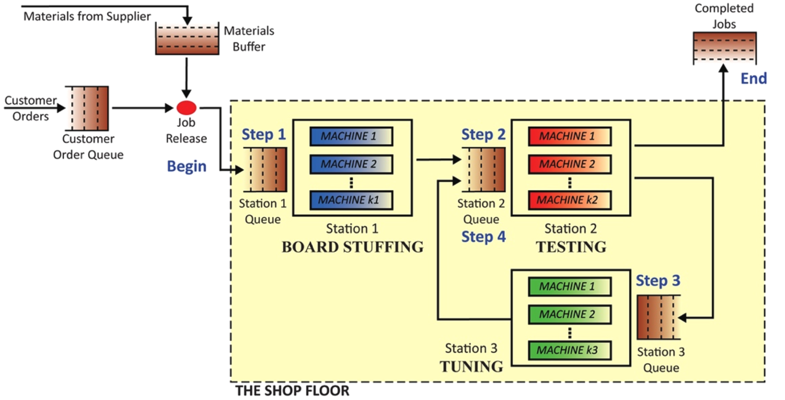
Littlefield Interface
View completed jobs, lead times, revenues
Decide order quantity (Q) and reorder point (R)
Choose contract and view historical/current demand
Buy new machine(s) or sell existing machines
and view utilization
View historical/current queue length
Real-time ranking
History of your team’s decisions
Cashflow (revenue / cost)

Slide 6
Littlefield Team Strategy
Decision | Comments
Machine purchase
Contract to offer
Order quantity
Reorder point
End game
Think about how concepts developed in course can be applied to help make these decisions.
Think, too, about when you have enough information to be able to apply a tool (e.g., queueing formula, (Q,R) model) directly and when you should instead only rely on qualitative insights about the tool/concept.
4 Strategy Slides (due Friday 4/22)
Machine purchase + Order quantity
+ Reorder point + End game
Notes:
Decisions you need to make in Littlefield
You can use several tools that we have analyzed
Machine purchase: capacity decisions. Things that can be considered: queueing, uncertainty in demand, variability in service…
Contracts: congestion in system, queueing, capability
Order/reorder: already discussed in previous slide
End game: you can’t change decisions for the last 100 days of the simulation, decisions need to be made just before
How much to order?
One option: one last big order; what tool can be used?

Slide 7
Little’s Law Recap
The fundamental relationship between inventory, flow rate, and flow time is known as Little’s Law:
average
average
average
= x
Inventory (I) flow rate (R) flow time (T)
(number of units
in system)
(rate at which units
enter and leave system)
(time unit spends
in system)
flow rate
inventory
flow rate
flow time
Notes:
Out of the three fundamental performance measures (I,R,T), two can be chosen by management, the other is GIVEN by nature
Hold inventory constant: Reducing flow time => increasing flow rate
Once you have two out of the three fundamental performance measures, you can compute the third

Slide 8


Little’s Law Applications
New Hires
Departures
Inflow
Outflow
Average tenure on departure
Average time $ is in process
I = R x T
I = # workers in the organization
R = # workers leaving the organization
T = Average tenure on departure
I = R x T
I = $ of inventory in the process
R = $ flow through process (COGS)
T = Time $ is in the process (days/years of supply)

Slide 9

Case: Rent the Runway

Slide 10


Rent the Runway
RTR’s “unlimited” subscription plan allows customers to have 4 apparel items out (at home or in the mail) at-a-time. When customer returns an item, RTR, upon receipt, mails the next item the customer requests.
Simplifying assumptions:
All RTR customers…
…are on “unlimited” plan (i.e., ignore other service offerings)
…receive and return items via mail
…request new item immediately upon notification of Rent the Runway’s receiving a used item.
MAIL
MAIL
RENT THE RUNWAY

Slide 11
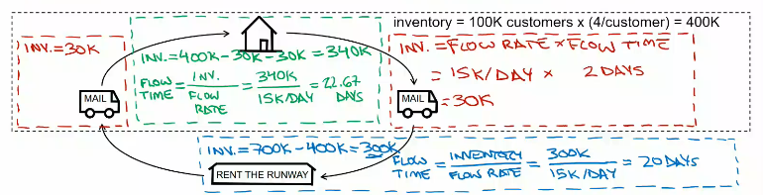
RTR Process Analysis
Problem Data:
Subscriber base is 100,000
Subscription plan is 4 apparel items out (at home or in the mail) at-a-time
Average shipping time = 2 days each way
RTR ships 15,000 items per day on average from its processing facility/warehouse
Total RTR inventory is 700,000 items
Questions:
1. How much inventory on average is in transit, with customers, and in RTR’s processing facility/warehouse?
2. How long does a customer keep an apparel item on average?
3. What is the average time an apparel item spends in their processing facility?

Slide 12
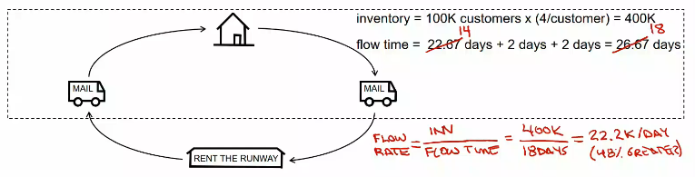
RTR Quick Return Proposal
“Quick Return” Proposal:
A newly hired RTR manager is concerned that, without imposing limits on the time a customer could keep an apparel item, the subscription business will never be profitable. The manager proposes offering $10 off the monthly subscription price to any customer who returns all items within 14 days.
Task:
Analyze the impact of the “Quick Return” Proposal on RTR’s profitability assuming:
- All customer avail themselves of the discount
- The customer base size is unchanged
- The average time a customer keeps an apparel
item drops to 14 days.

Slide 13
Intro to Queueing

Slide 14
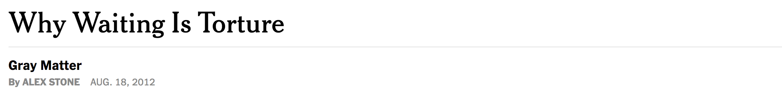


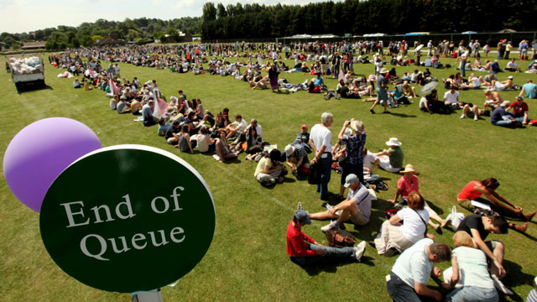
“Americans spend roughly 37 billion hours each year waiting in line.”
← Queue at Wimbledon 2013
The average adult in the UK wastes 5 hours and 35 minutes queueing each month
(The Telegraph, 2009)
An Englishman, even if he is alone, forms an orderly queue of 1
(George Mikes)
Source: Bendik Kaltenborn, NYTimes SundayReview “Why Waiting is Torture” by Alex Stone on August 18, 2012
https://www.nytimes.com/2012/08/19/opinion/sunday/why-waiting-in-line-is-torture.html

Slide 15
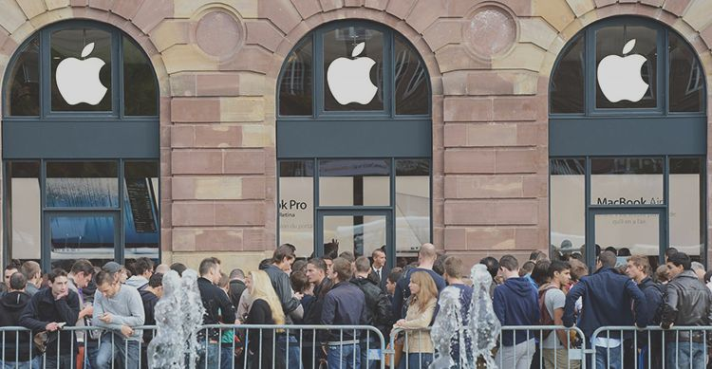
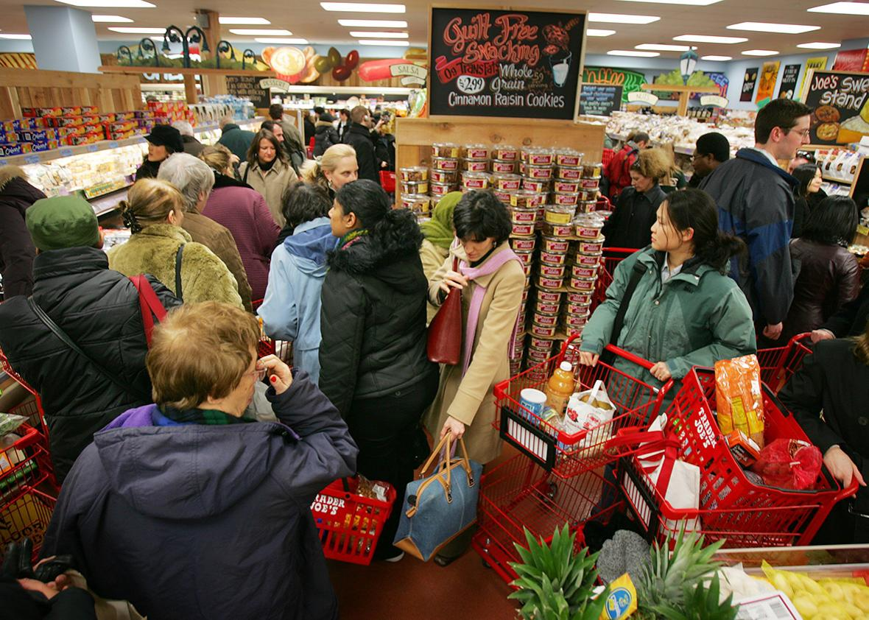
Why Do Queues Exist?
Seasonality: An arrival rate that predictably exceeds the service rate (i.e., capacity) of a process.
E.g., line at Apple Store on the day the new iPhone launches
Variability: Variation in the arrival and service rates in a process where the average service rate is more than adequate to process average arrival rate.
E.g., visits to a grocery store are unusually high during a particular hour relative to the same hour in other weeks (i.e., visits are high by random chance).
Notes:
variability: arrival process and service times.
measures: number of customers in queue, number of customers in system, the waiting time before service begins, the total time spent in the system, the prob of delay (take any customer, what is the probability that the customer has to wait?) so on
One can simulate either by hand or by computer to determine these performance measures.
What we want to do for the rest of the class is not simulation, but to introduce several queueing models that can be used to predict the performance of a queueing system.

Slide 16

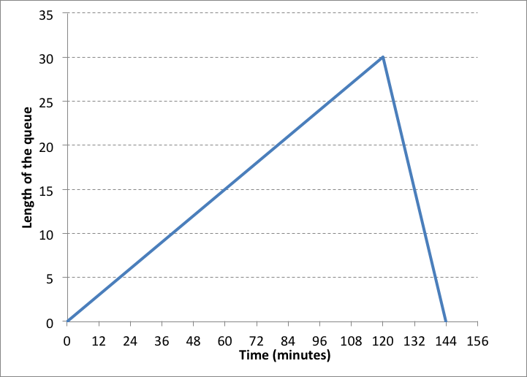
Predictable Demand
Rental shop parameters (8-10am) | Customers per minute
Demand | 1.50
Capacity | 1.25
Demand exceeds capacity:
Queue growth rate
= Demand – Capacity
= 1.5 – 1.25
= 0.25 cust/min
120 mins x 0.25 cust/min = 30 customers
0.25 cust/min

Slide 17
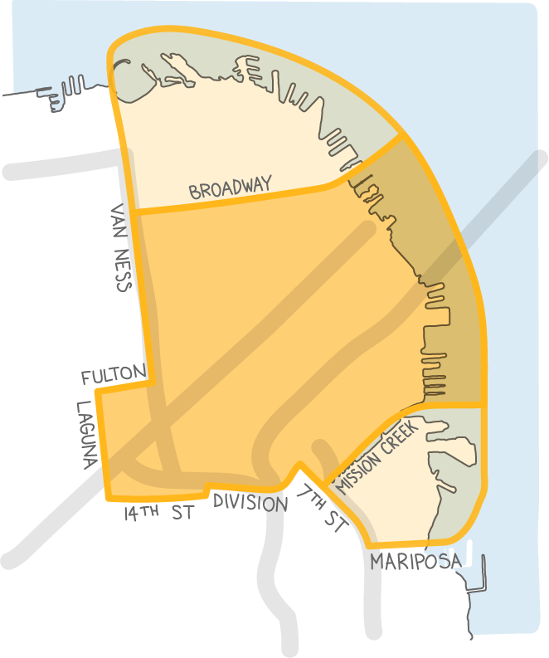
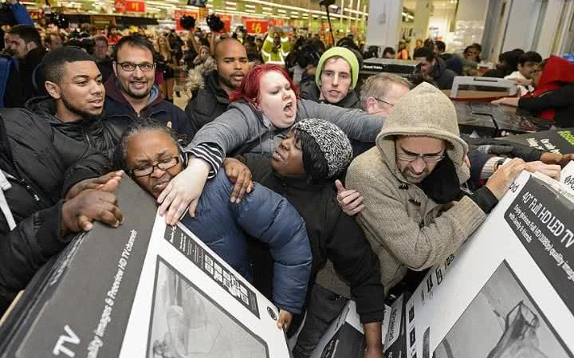

What Can Dodge Ridge Do?
Peak-load pricing (also known as congestion pricing):
Charge more during the peak demand period (or give a discount during the off-peak demand period).
The goal is to reduce Demand during the peak time.
Temporary capacity for the peak period:
Increase staffing/equipment during the peak period.
For example, part-time or temp workers.
Pre-processing strategies:
Design the process so that some of the work can be done off-peak, thereby increasing peak period capacity by reducing processing times.
For example, have customers fill out waiver forms on-line before they arrive.

Slide 18
Dr Toyota The Perfect Doctor?
Patient
Arrival
Time
Service
Time
1
0
4
2
5
4
3
10
4
4
15
4
5
20
4
6
25
4
7
30
4
8
35
4
9
40
4
10
45
4
7:00
7:10
7:20
7:30
7:40
7:50
8:00
11
50
4
12
55
4
Notes:
Imagine a workflow where work just shows up as often as we like it, evenly spaced. In this case, Dr .Toyota gets patients every 5 minutes. And ideally we would spend the same amount of time with each patient, in this case 4 minutes. So essentially, no one has to wait at all to see Dr. Toyota.
Well you can see that this is not very realistic.
Life is much more complex than that.
Rather than patients or customers arrive exactly every 5 minutes,

Slide 19
A More Realistic Service Process
Arrival
Time
Service
Time
Patient 1
Patient 3
Patient 5
Patient 7
Patient 9
Patient 11
Patient
Patient 2
Patient 4
Patient 6
Patient 8
Patient 10
Patient 12
1
0
5
2
7
6
Time
3
9
7
7:00
7:10
7:20
7:30
7:40
7:50
8:00
4
12
6
5
18
5
6
22
2
3
7
25
4
2
8
30
3
Number of cases
9
36
4
1
10
45
2
0
11
51
2
2 min.
3 min.
4 min.
5 min.
6 min.
7 min.
Service times
12
55
3
Notes:
Rather than patients or customers arrive exactly every 5 minutes, they might be arriving on average exactly every 5 minutes but there is variation from one customer to another. Right, so, here we’re not talking about scheduled arrivals but rather walkins that you see a lot at most services, coffee shops, restaurants, emergency departments, or theme parks. And even if some arrivals are scheduled, people might run late for example.
12 patients show up over the course of the hour. Same as before.
On average, it takes us 5 minutes to work on a single case. But again there is variation in service times as well. Some patients want to ask for some tips to sleep better, some want to learn more about diet, or some might just want to come to get a quick prescription. At a Subway restaurant, some might want more tomatoes, more pickles, etc.

Slide 20
Waiting Due to Variability
Arrival
Time
Service
Time
Patient
Service time
1
0
5
2
7
6
3
9
7
Wait time
4
12
6
5
18
5
6
22
2
7:00
7:10
7:20
7:30
7:40
7:50
8:00
7
25
4
5
Inventory
(Patients at clinic)
8
30
3
4
9
36
4
3
10
45
2
2
11
51
2
1
0
12
55
3
7:00
7:10
7:20
7:30
7:40
7:50
8:00
Notes:
Go back to the base case, none of these patients have to wait.
But now even though I’m having the same number of patients, the same amount of work. We can see that the waiting time is actually quite substantial. You see specificially here Patients 4 through 9, they are waiting longer than their actual service time.
Waiting room, we see here at the bottom some of these patients have to wait before getting the service. some times it’s 3-4 patients in the waiting room, although again on average we have enough capacity.
What’s the utilization of Dr. Toyota? Think about that for a moment.
Utilization is flow rate divided by capacity. U = FR/CAP
FR = patients coming every 5 minutes. 1/5, how many patients coming in per unit time
Capacity = number of resources / processing time
1 doctor -> 4 minutes :1/5 / ¼ = 80%
Doesn’t change in any calculation Still 80% here.
But fair bit of waiting time going. Substantially inventory in the waiting room.
You say 80% come on they’re so lazy, no utilized enough
But now you look at 80%, say maybe that’s too much. Maybe these services are no longer responsive
And that’s really the heart of the matter here in a world of variability I have to rethink, I have to reframe how I think about utilization. And we will see over the coming sessions the idea of lean and variaibility. They don’t like each other. From the lean perspective, 80% utilization = 20% under utilized
From the variability perspective, it means there’s more waiting time that I want here. And that could be pretty problematic if this is a time critical service We have to think about modeling this variability

Slide 21
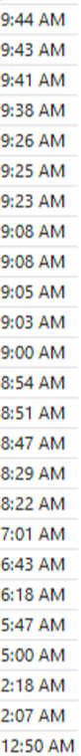
Variability in Demand
Arrival time: The time a flow unit or a customer request arrives (average arrival rate = λ)
Inter-arrival time: The time that passes between two consecutive arrivals.
We’ll use two parameters to describe interarrival times to a process:
The average interarrival time “a”
The standard deviation of the interarrival times.
The SD is a measure of how variable the inter-arrival times are.
Common distribution for a
Exponential distribution: mean = SD = 1/λ
(# arrivals are Poisson distributed)
18 minutes
7 minutes
Notes:
How do I expand my toolbox to capture the fact that even a utilization of 80% can actually come along with substantial waiting time?
Here emails I got last night from midnight, you can go to your email inbox and I’m sure you have similar thing. You have these timestamps (=arrival rate) and now I’m going to define the difference between 2 timestamps within 2 subsequent email arrivals as the inter-arrival time.
In the spirit of Dr. Toyota, it’s a thought experiment that is kind of weird. There is no real process that operates like Dr. Toyota. And so I want to capture the fact that these interarrival times here are somewhat random or they’re drawn from some distribution. This distribution has a STD and a mean.
Roughly speaking, the standard deviation is a measure of how variable the inter-arrival times are.
The standard deviation is an absolute measure of variability. Two processes can have the same standard deviation but one can seem much more variable than the other. Below are random samples from two processes that have the same standard deviation. The left one seems more variable.
Here, the two are plotted relative to their average and with the same axes.
Relative to their average, the one on the left is clearly more variable (sometimes more than 400% above the average or less than 25% of the average)
The coefficient of variation is a measure of the relative variability of a process – it is the standard deviation divided by the average.
Now some of you might have heard about things such as exponential interarrival time and Poisson processes. research shows very clearly that you can have a long and happy life without knowing what a Poisson process is.
But if you have heard these terms I want to say that if arrivals are random, the number of arrivals in a time interval is Poisson distributed and the interarrival times are actually exponentially disttirbuted. These arrive randomly rather than scheduled. Randomly people get sick. Randomly people feel like they need to make a new loan. If these things are happening independently from each other, the CVA is going to be converging to 1.

Slide 22
Relative/Absolute Variability
The standard deviation is an absolute measure of variability.
Two processes can have the same standard deviation but one can seem much more variable than the other:
Below are random samples from two processes that have the same standard deviation. The left one seems more variable.

Slide 23
Relative/Absolute Variability
The previous slide plotted the processes on two different axes.
Here, the two are plotted relative to their average/same axes.
Relative to their average, the the left is more variable (sometimes > 400% above the average or < 25% of the average)

Slide 24
Coefficients of Variation
The coefficient of variation (CV) is a measure of the relative variability of a process – it is the SD divided by the average.
The coefficient of variation of the arrival process:
CV_{a} = 10 /10 = 1
CV_{a} = 10 /100 = 0.1

Slide 25
Variability in Processing Time
800
Processing time: The time to process one flow unit or request (often times also called service time)
p: average processing time (each p is a random variable)
Coefficient of variation: The ratio between the SD and the mean processing time (zero if deterministic)
CV_{p} =
Common distributions: Exponential (CV=1), Beta, LogNormal
600
Frequency
400
200
St-Dev(processing times)
0
Average(processing times)
0
100
200
300
400
500
600
700
800
900
1000
Call durations (seconds)
Practice: Average processing time = 120 secs, SD = 150 secs
→ CV_{p} = 150 / 120 = 1.25
Notes:
You also have variability in the service process. This is especially an issue when we’re dealing with customers. If you’re at Subway, some want more tomatoes and pickles, they want you to toast the sandwich twice.
These variabilities are Outside your control
For this hypothetical call center, processing time for a sample of customers. Again you see the world of statistic kind of works,, in the sense that some customers spend short time and some take little bit longer
There’s going to some form of distribution.
For the purpose of this class, it doesn’t matter.
We only need the standard deviation and the mean
Then we can compute the COV for the processing time.
Can have many distributions:
CVp depends strongly on standardization
Often Beta or LogNormal

Slide 26
A Multi-Server Queue
Arriving customers
Departing customers
Customers waiting for service
Multiple
servers
Assumptions:
All servers are equally skilled, i.e., they all take p time to process each customer.
Each customer is served by only one server.
Customers wait until their service is completed.
There is sufficient capacity to serve all demand.
a = average interarrival time
Demand = 1 / a
p = average processing time
Capacity of each server = 1 / p
m = number of servers
Capacity = m x 1 / p
Notes:
So for a general case with any number of servers, but still one queue.
Assumptions:
All servers are equally skilled, i.e., they all take p time to process each customer.
Each customer is served by only one server.
Customers wait until their service is completed.
There is sufficient capacity to serve all demand.

Slide 27
(Implied) Utilization
Arriving customers
Departing customers
Customers waiting for service
Multiple
servers
Implied utilization = Demand / Capacity
= (1 / a ) / (m x 1 / p )
= p / (a x m )
Utilization = Flow Rate / Capacity
If Demand < Capacity, then Flow Rate = Demand and …
Utilization = Implied utilization = p / (a x m )

Slide 28

Utilization Example
At Trader Joe’s in Rockridge
a = 35 seconds between customers
p = 120 seconds per check-out
m = 4 check-out registers
Then
Demand rate = 1 / 35 customers per second
Capacity of each server = 1 / 120 customers per second
Capacity = m x 1 / p = 4 x 1 / 120 = 1 / 30 customers per second
Implied utilization = Demand rate / Capacity
= p / (a x m)
= 120 / (35 x 4)
= 85.7%
Notes:
A 86% utilization means:
At any given moment, there is a 0.86 probability a server is busy serving a customer and a 1-0.86 = 0.14 probability the server is idle.
At any given moment, on average 86% of the servers are busy serving customers and 100% – 86% = 14% are idle.

Slide 29
Implications of Utilization
A 86% utilization means:
At any given moment, there is a 0.86 probability a server is busy serving a customer and a 1-0.86 = 0.14 probability the server is idle.
At any given moment, on average 86% of the servers are busy serving customers and 100% – 86% = 14% are idle.

Slide 30
Queue Stability
If implied utilization < 100% then:
The system is stable, which means that the size of the queue does not keep growing over time. (Capacity is sufficient to serve all demand.)
If implied utilization >= 100% then:
The system is unstable, which means that the size of the queue will continue to grow over time.
We will only analyze stable queues.

Slide 31
Queue Stability Examples
Stable queue
a = 35; p = 120; m = 4
Implied utilization = 86%
Utilization = 86%
Unstable queue
a = 35; p = 120; m = 3
Implied utilization = 114%
Utilization = 100%

Slide 32
Preview Waiting Time
T_{q} = Time in queue
Recall: p = Processing time, m = number of servers
The above Time in queue equation works only for a stable system, i.e., a system with implied utilization less than 100%, with one line.
Notes:
Wouldn’t be nice if I could have a formula for that
Predict how much waiting is it going to be as a function of some inputs. It will have to do with the variability, Cva and CVp. Also the utilization. If utilization is high, we expect more waiting.

Slide 33
Waiting Time Example
At Trader Joe’s in Rockridge:
a = 35 seconds, p = 120 seconds, m = 4
Utilization = p / (a x m) = 85.7%
CV_{a} = 1, CV_{p} = 1.25
On average, a customer waits 193 seconds in a line for the check-out.

Slide 34
What’s Next
HW5 out (7 Qs on Queue, 3 Qs on Strategy)
Looking ahead…
This week: 2nd Project Sponsor Meeting
Today: Access to Littlefield platform + demand data
Friday: HW4 due (you can submit HW4 or HW5)
Next Week: 75-hour online Littlefield Simulation
Starts Monday 1pm and ends Thursday 4pm
No classes on Mon/Wed, you can use the room!

